Slide 1
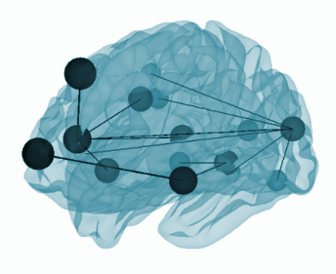

Smooth graph learning for functional connectivity estimation -
Leveraging Graph Signal Processing for fMRI Data Analysis
Presented by Tali Aharon 034791236
Siyuan Gao, Xinyue Xia, Dustin Scheinost, Gal Mishne
Neuroimage. 2021 Oct.

Slide 2


01.
UNDERSTANDING THE CONTEXT
An Introduction to fMRI data complexity
02.
METHODS - RELATED STUDIES BEFORE SGFC
Presenting a timeline for the different studies and methods
03.
SGFC STUDY
Presenting the method and its advantages and disadvantages
04.
EXPERIMENTS
Learning FC, Fingerprinting, Prediction of Fluid Intelligence and Topological Analysis
05.
TABLE OF
CONTENT
CONCLUSIONS
Conclusions and some suggestions for future research

Slide 3
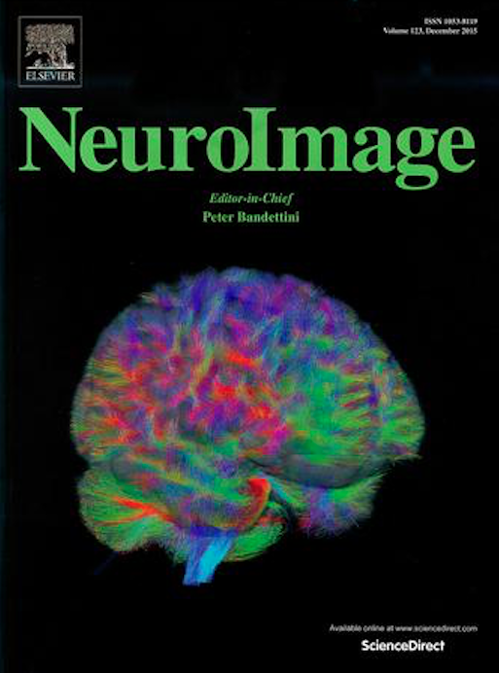
ABOUT THE PAPER
Smooth graph learning for functional connectivity (SGFC) estimation
Authors:
Siyuan Gao, Xinyue Xia, Dustin Scheinost, Gal Mishne
Universities:
Yale University, University of California San Diego
Year: 2021
Published at NeuroImage

Slide 4
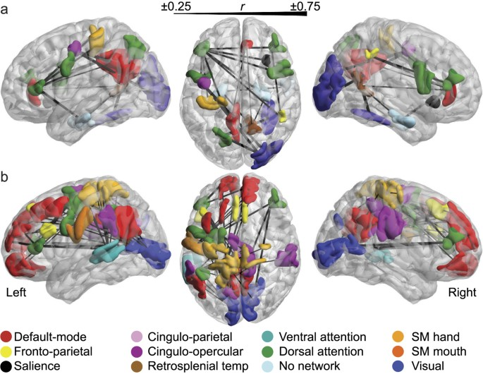
Introduction - The Importance of Brain Networks
Studying brain networks can help us understand:
The underlying principles of brain organization and function
How information is processed and integrated in the brain
Which regions work together on specific tasks
How brain networks are disrupted in neurological and psychiatric disorders
How interventions (therapy or medication) may impact brain function and connectivity
Figure from: Hearne, L., Mattingley, J. & Cocchi, L. Functional brain networks related to individual differences in human intelligence at rest. Sci Rep 6, 32328 (2016). https://doi.org/10.1038/srep32328

Slide 5
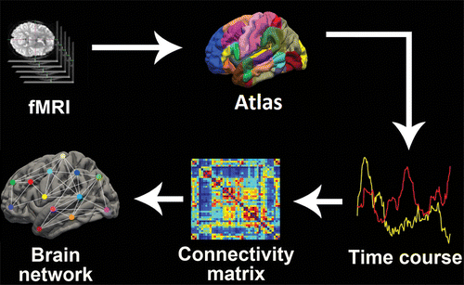
Construction of a Functional Brain Network
https://doi.org/10.1148/radiol.2019194009

Slide 6
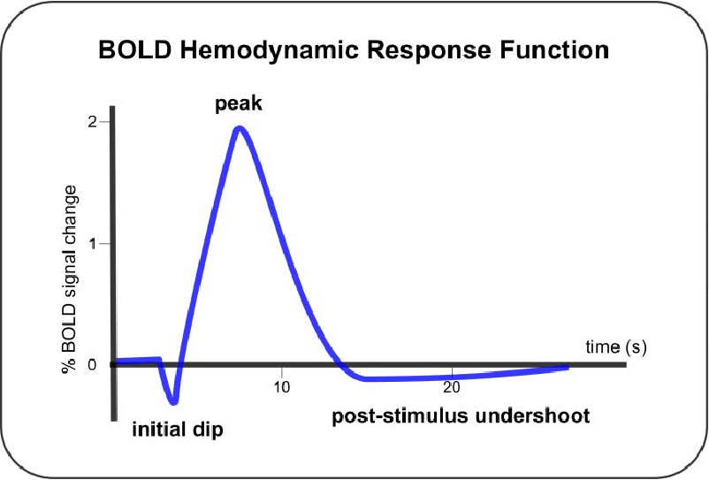
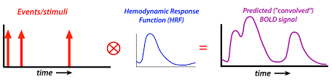
BOLD - The Blood Oxygenation Level-Dependent Signal
Functional MRI (fMRI) provides a blood oxygen level–dependent (BOLD) signal for each voxel across time.
The BOLD signal (Blood Oxygen Level Dependent signal):
A measure of brain activity detected by fMRI.
Areas of the brain that are more active tend to receive higher levels of oxygenated blood.
https://andysbrainbook.readthedocs.io/en/latest/glossary/terms/BOLD_Response.html
and https://mri-q.com/glm-advanced.html

Slide 7
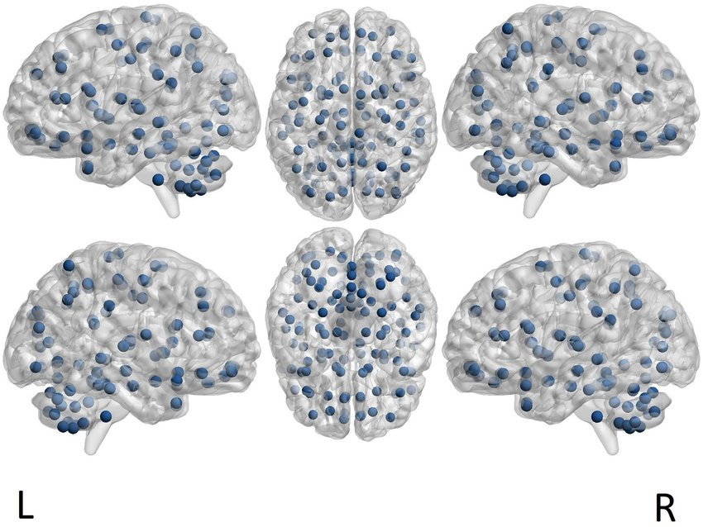
Atlas and Parcellation
Parcellation - the process of dividing a structure, such as the brain, into smaller parcels (also called ROI/VOI) based on:
Anatomical features
Functional characteristics
In the SGFC study, fMRI data was parcellated into 268 nodes using a whole-brain functional atlas (Shen et al., 2013).
ROI centers as defined by the AAL parcellation.
The brain illustration is a template provided, handled and visualized with BRAINNET VIEWER TOOL https://doi.org/10.1371/journal.pone.0215720.g001

Slide 8

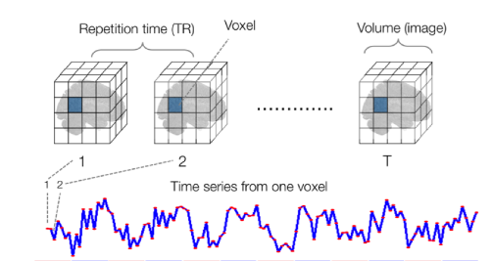
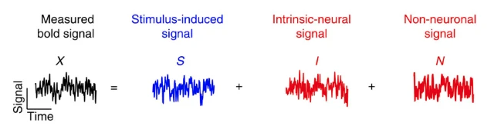
Multivariate BOLD Time Series
The Volume (3D Image) of fMRI depends on a number of factors, including:
the slice (x and y)
and the slice thickness (z)
Voxel: Same as pixel but in 3D.
Voxel’s value: its BOLD response signal value.
Repetition time (TR): how often the same slice is imaged over time.
The bold signal contains the stimulus-induced signal but also some noise
Simony, E., Honey, C., Chen, J. et al. Dynamic reconfiguration of the default mode network during narrative comprehension. Nat Commun 7, 12141 (2016).

Slide 9
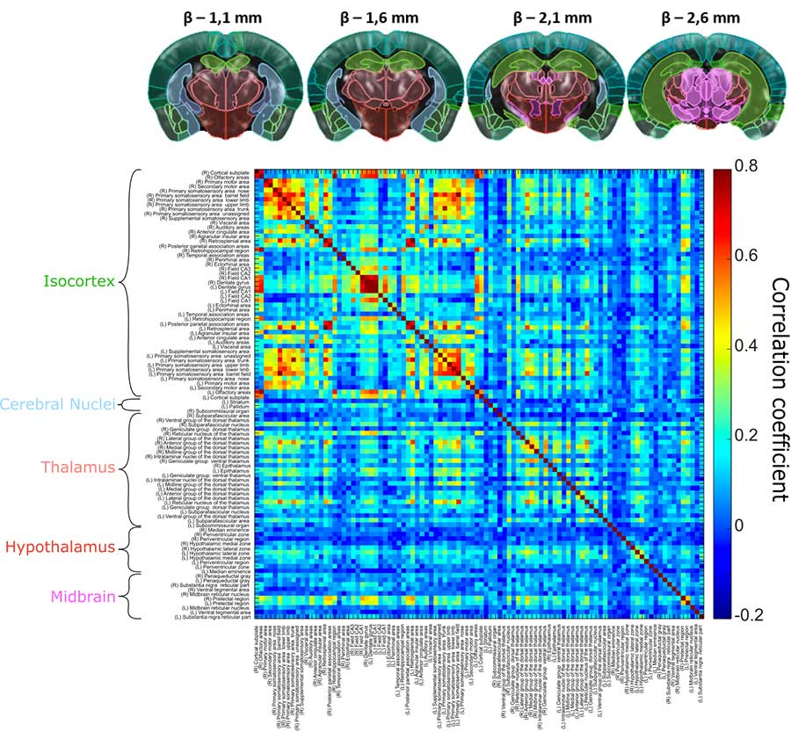
Functional Connectivity (FC)
Statistical association/correlation between the activities of different brain regions, indicating how these regions work together during cognitive processes or tasks.
Used in neuroimaging studies to understand the functional organization of the brain.
The use of individual-specific patterns of functional connectivity (FC) in the brain as a unique "fingerprint" for identifying individuals.
Challenges:
Lack of ground truth
Interpretation of negative correlations
Non-linear distance (for comparison between FCs)
The Complexity of Brain Networks
From: https://iconeus.com/applications/functional-connectivity/

Slide 10
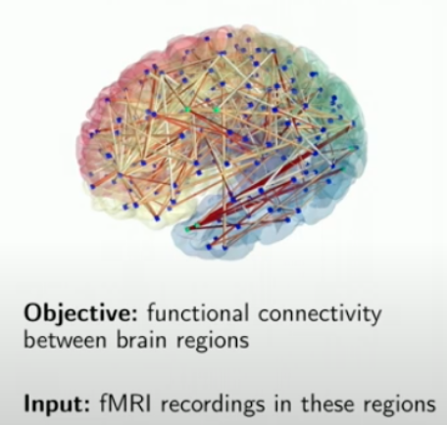
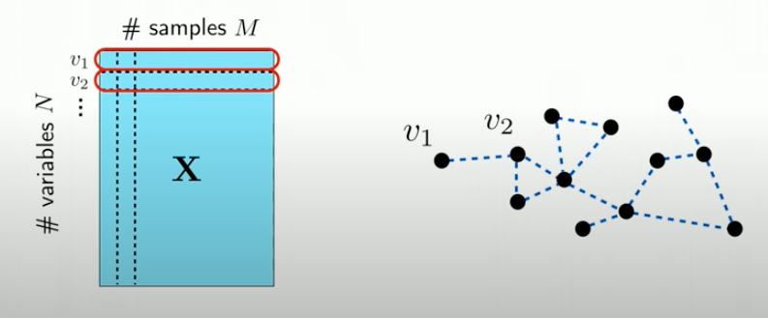
Modeling Brain Networks as Graphs
We treat the brain just like any other network - we can model it as a graph of nodes:
N - The nodes (representing the ROIs)
M - the number of times the same slice is imaged over time
To understand the connectivity patterns between the ROIs, we need to learn the Topology - the weights on the edges.
From: Xiaowen Dong: Learning graphs from data: A signal processing perspective.
https://www.youtube.com/watch?v=2ds4A11DSOw

Slide 11
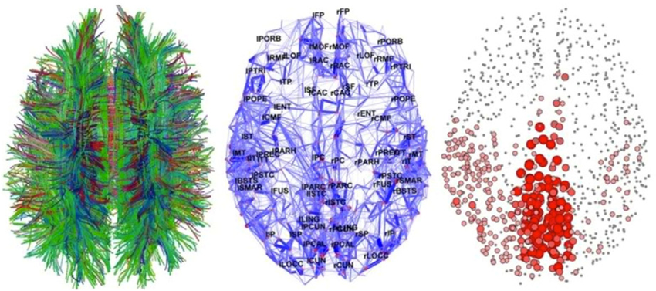

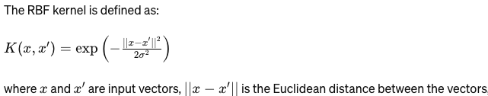
Network Reconstruction: Traditional Approaches
Physical -
Diffusion Process
Statistical:
Sample Correlation - e.g. Pearson
Similarity Function - e.g. Gaussian RBF:
Diffusion Tensor Tractography (left), graph of connectivity (center), functional connectivity (right). Modified from Hagmann P, Cammoun L, Gigandet X, Meuli R, Honey CJ, Wedeen VJ, Sporns O (2008) Mapping the structural core of human cerebral cortex. PLoS Biology.

Slide 12
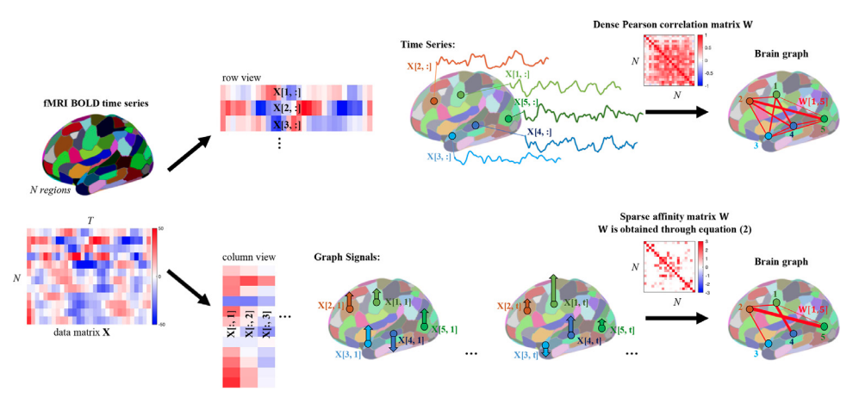

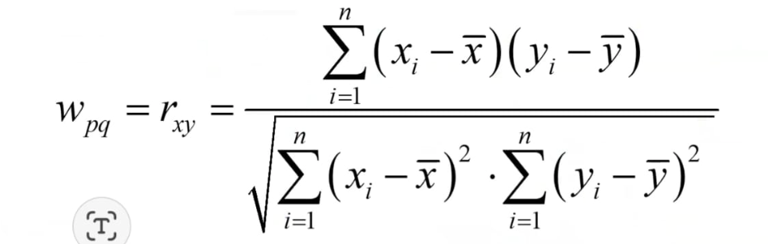

CFC - Correlation Functional Connectivity
Define the nodes (for 𝑁 brain ROIs)
Calculate pairwise Pearson correlation coefficients between the time-series of the 𝑁 nodes.
Estimate a dense FC matrix.
Threshold the resulting matrix.
Pros:
Simple and widely used.
Provides a measure of the relationships between regions.
Cons:
CFC assumes linear surface when comparing distances.
Sensitive to noise and outliers.
Xp= time series (signal) of vertex p
Yq= time series (signal) of vertex q

Slide 13
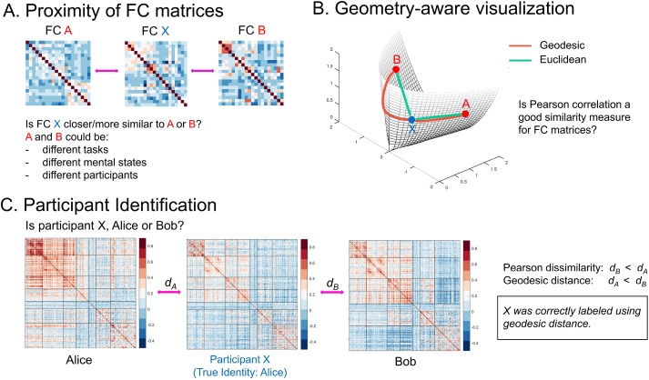
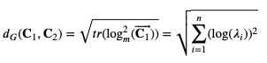
A Solution - Geodesic Distance-Based FC
CFC lies on a positive semidefinite cone (symmetric with non-negative eigenvalues)
The geometry is not Euclidean - It’s a Manifold
The geodesic distance between two covariance matrices 𝐂1 and 𝐂2 =
Pros:
Provides a more accurate measure of distance between FC matrices.
Cons:
Requires complex calculations and assumptions about the underlying geometry.
Lead to positive and negative relations.
https://doi.org/10.1016/j.neuroimage.2019.116398

Slide 14
The Transition to Laplacian and GSP - 2013
Both methods have limitations in capturing the complex and dynamic nature of brain networks.
What should we do if:
We need to learn a graph with non-negative weights?
The signal has specific characteristics (such as smoothness), shouldn’t that affect the underlying graph?
We start by understanding the importance of the underlying graph and the concept of smoothness
2013
Shuman et al.
The emerging field of signal processing on graphs: Extending high-dimensional data analysis to networks and other irregular domains
2015
Hu et al.
A Spectral Graph Regression Model for Learning Brain Connectivity of Alzheimer‘s Disease
Jan 2016
Kalofolias
How to learn a graph from smooth signals
Feb 2016
Dong et al.
Learning Laplacian Matrix in Smooth Graph Signal
Representations
2019
Dong et al.
Learning
Graphs
From Data
A signal representation perspective
2021
Gao et al.
Smooth graph learning for functional connectivity estimation
Our article (SGFC) is here

Slide 15
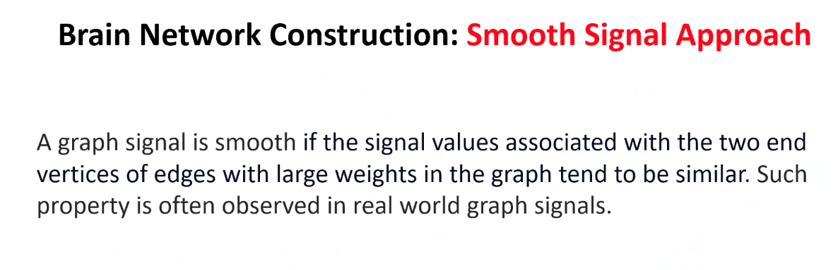
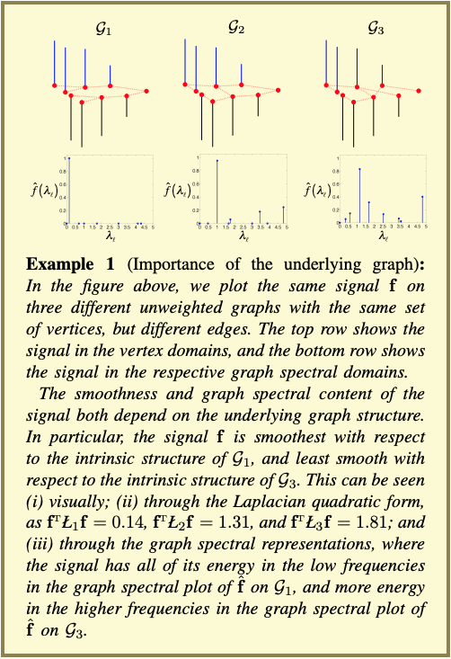
The signals representing brain activity are smooth with respect to the inferred graph, meaning that neighboring brain regions tend to have similar functional connectivity patterns
Shuman, D. I., Narang, S. K., Frossard, P., Ortega, A., & Vandergheynst, P. (2013). The emerging field of signal processing on graphs: Extending high-dimensional data analysis to networks and other irregular domains. IEEE signal processing magazine, 30(3), 83-98.‏

Slide 16
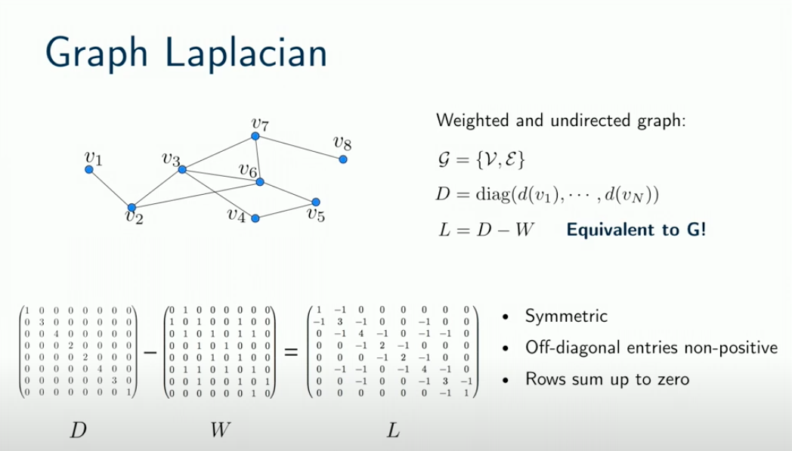
Why Graph Laplacian?
Equivalent to G
Approximation of the Laplace operator (denoted by ∇² or Δ)
A notion of “Frequency” on Graphs
A
A
From: Xiaowen Dong: Learning graphs from data: A signal processing perspective.
https://www.youtube.com/watch?v=2ds4A11DSOw

Slide 17
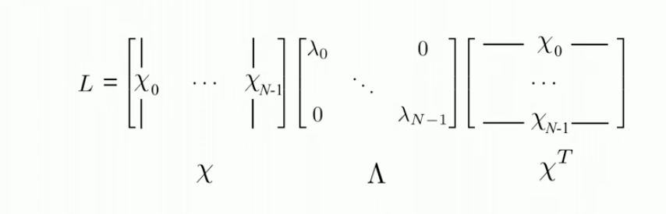
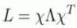
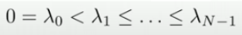
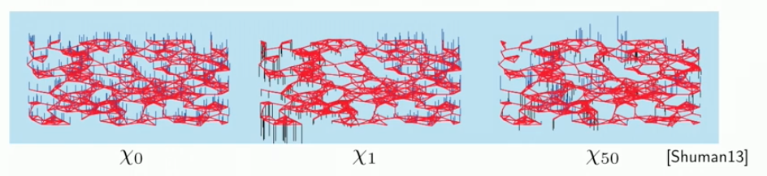
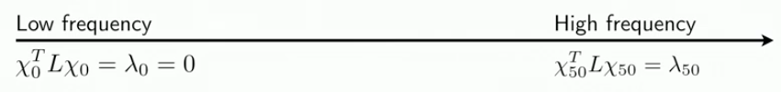
A Notion of “Frequency” on Graphs
L has a complete set of orthonormal eigenvectors:
The eigenvalues are sorted increasingly:
The eigenvectors X0 to XN-1 are vectors in ℝ𝑛
We can think of them as functions/signals on the graph.
X0 - the "constant eigenvector" - is the smoothest signal and we can see that indeed represents the lowest frequency.
As we continue and look at higher eigenvalues (high frequency) we see that the graph of eigenvectors less and less smooth.
From: Xiaowen Dong: Learning graphs from data: A signal processing perspective.
https://www.youtube.com/watch?v=2ds4A11DSOw

Slide 18
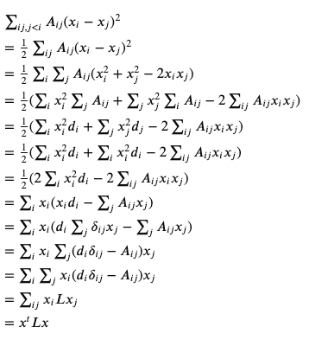
Dirichlet Energy of Graphs and Discrete Laplacian
In mathematics, the Dirichlet energy is a measure of how variable a function is.
Smoothness = low variability

Slide 19
Studies Using Laplacian and GSP - 2015
We start by understanding the importance of the underlying graph and the concept of smoothness
2013
Shuman et al.
The emerging field of signal processing on graphs: Extending high-dimensional data analysis to networks and other irregular domains
2015
Hu et al.
A Spectral Graph Regression Model for Learning Brain Connectivity of Alzheimer‘s Disease
Jan 2016
Kalofolias
How to learn a graph from smooth signals
Feb 2016
Dong et al.
Learning Laplacian Matrix in Smooth Graph Signal
Representations
2019
Dong et al.
Learning
Graphs
From Data
A signal representation perspective
2021
Gao et al.
Smooth graph learning for functional connectivity estimation
Introducing a graph regression model for learning brain structural connectivity of patients with Alzheimer’s disease, which is based on the signal smoothness model
Our article (SGFC) is here

Slide 20
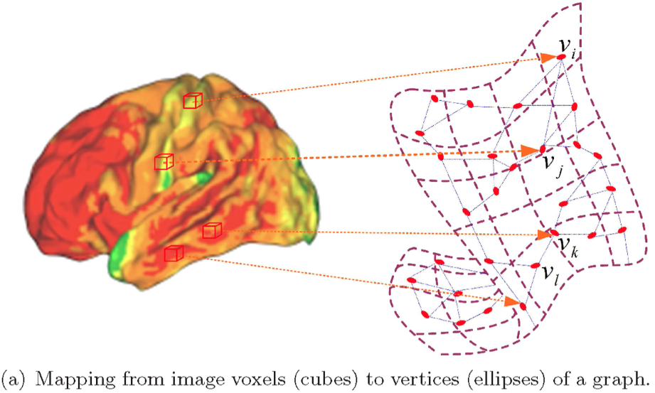
Hu et al. 2015 - A Spectral Graph Regression Model for Learning Brain Connectivity of Alzheimer‘s Disease
Nodes of the graph - N = 42 VOIs (=ROIs)
Value of node - the signal:
Features extracted from PiB-PET imaging data
Main feature measured - amyloid-β deposits in different brain regions
No time dimension (XN,M where M is the number of subjects/samples)
They try to predict the weights on the edges between the nodes, which represent the structural brain connectivity of Alzheimer's disease (AD)

Slide 21
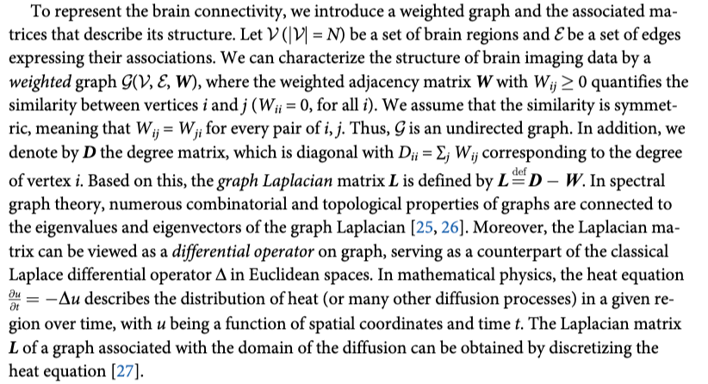
Graph Laplacian
In 2015, Hu already understood the important role of the Laplacian (and didn’t explicitly mention Dirichlet Energy but the concept was there) -

Slide 22
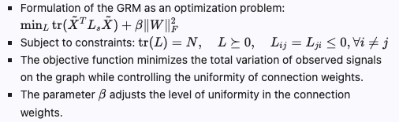
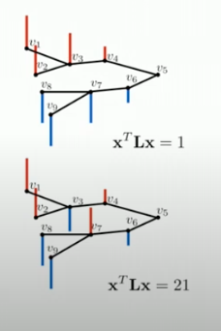
Graph Estimation - The Graph Regression Model (GRM)
Sparsity Control: The main objective of the regularization is to prevent overfitting and to perform feature selection by shrinking the less important features' coefficients to zero.
The Dirichlet energy is minimized
(Low variability = Smoothness)

Slide 23
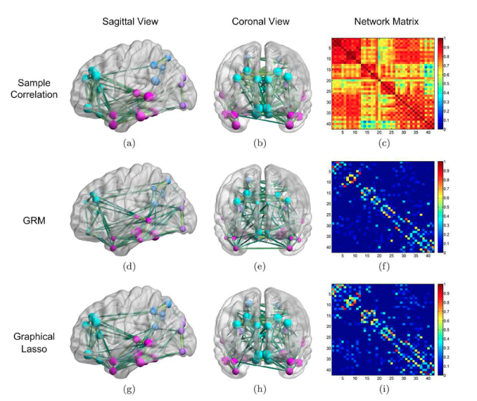
Network Learning Results - the AD Group
Reconstruction results from 30 AD subjects.
Horizontal/Vertical axes represent the brain region index.
Compared GRM with sample correlation and graphical Lasso.
The colors and sizes of the nodes indicate the associated brain lobes and node degrees, respectively;
The thicknesses of the 144 prominent edges encode the connection strengths.
Diagonal removed to ease visualization.
Comparison -
In contrast to the noisy sample correlation, the resulting Laplacian matrix in GRM extracts cleaner and potentially more meaningful information from the data.

Slide 24
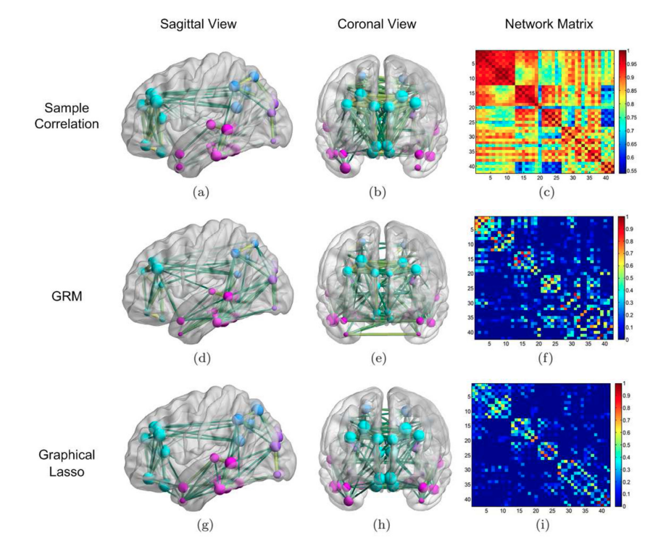
Network Learning Results - the NC Group
Reconstruction results from 40 Normal Control subjects.
For both GRM and graphical Lasso, results are obtained by keeping the same parameters as in the previous AD case.

Slide 25
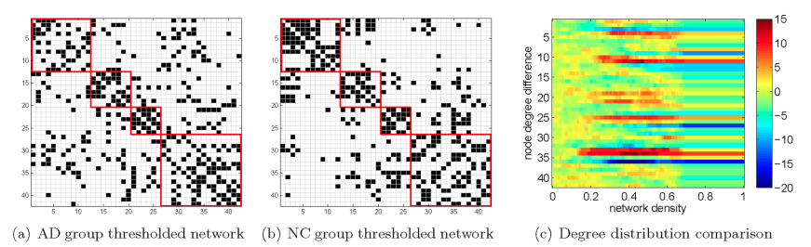
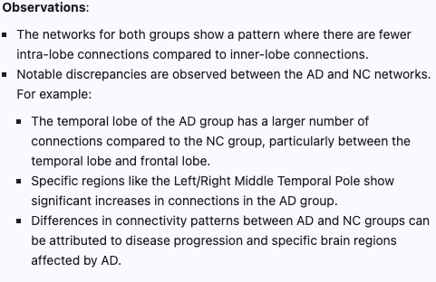
Comparison - AD vs. NC networks
Network Comparison:
The adjacency matrices of the brain networks for the AD and NC groups are visualized in (a) and (b) after thresholding with 187 edges in both cases (black pixels).
The 4 main Hubs/Regions are highlighted by red squares.

Slide 26
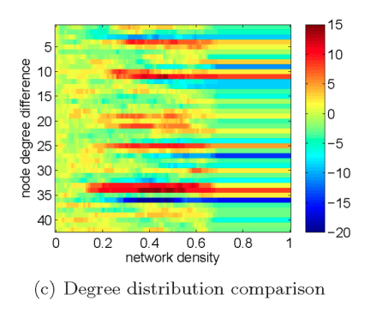
Comparison - Degree Distribution Comparison
Degree Distribution:
The degree distributions of the AD and NC groups are compared to identify nodes with large discrepancies in degree between the two groups.
Density/Sparsity control: Variations in degree distributions at different densities may indicate specific regions or connections that are more affected in AD compared to NC, providing valuable information about the brain network alterations associated with the disease.

Slide 27
Learning Graphs from Data - 2016
We start by understanding the importance of the underlying graph and the concept of smoothness
Learning graphs from data
2013
Shuman et al.
The emerging field of signal processing on graphs: Extending high-dimensional data analysis to networks and other irregular domains
2015
Hu et al.
A Spectral Graph Regression Model for Learning Brain Connectivity of Alzheimer‘s Disease
Jan 2016
Kalofolias
How to learn a graph from smooth signals
Feb 2016
Dong et al.
Learning Laplacian Matrix in Smooth Graph Signal
Representations
2019
Dong et al.
Learning
Graphs
From Data
A signal representation perspective
2021
Gao et al.
Smooth graph learning for functional connectivity estimation
Introducing a graph regression model for learning brain structural connectivity of patients with Alzheimer’s disease, which is based on the signal smoothness model
Our article (SGFC) is here

Slide 28
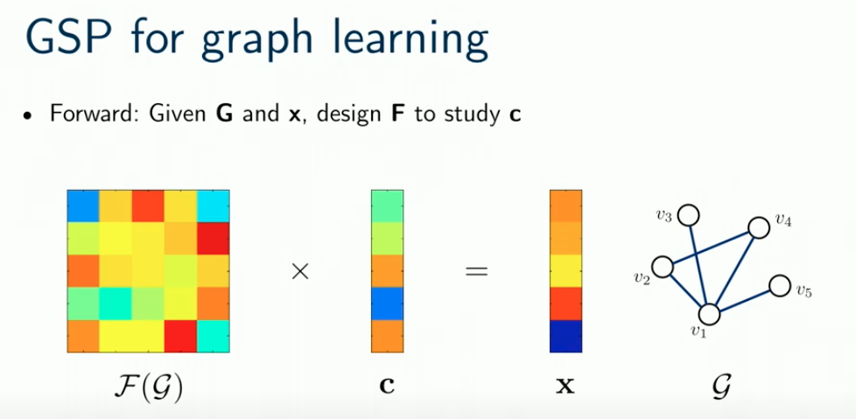

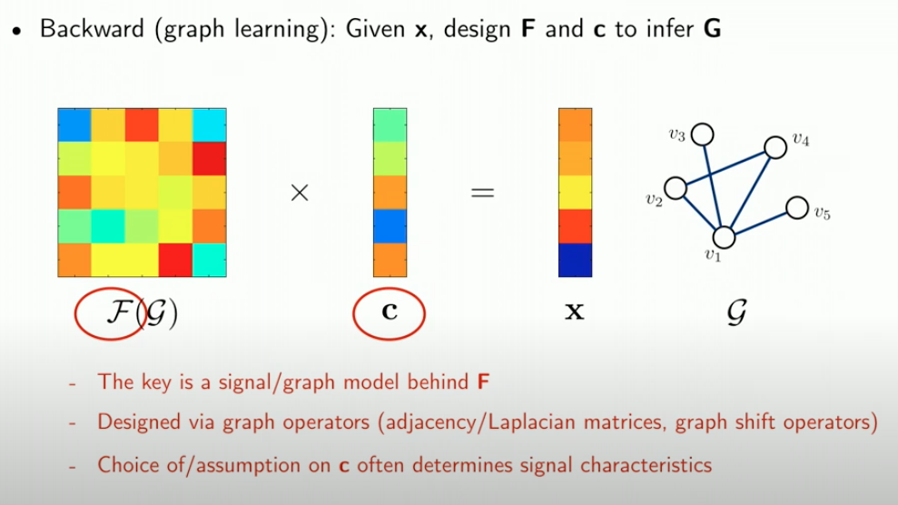
Graph Learning - Dong et al. 2016
Graph Learning (the “Backward” case) -
We look for a Meaningful Data Model X ~ F(G) where:
x (known) - our observations
F (unknown) - the topology over G that we wish to learn
c (unknown but can be assumed) -
x is represented as a linear combination of the columns of F.
We should incorporate prior knowledge of signal characteristics when estimating c (such as the Assumption of Smoothness)
The key is a signal/graph model behind F that is designed via graph operators, such as Adjacency/Laplacian matrices
Xiaowen Dong: Learning graphs from data: A signal processing perspective

Slide 29
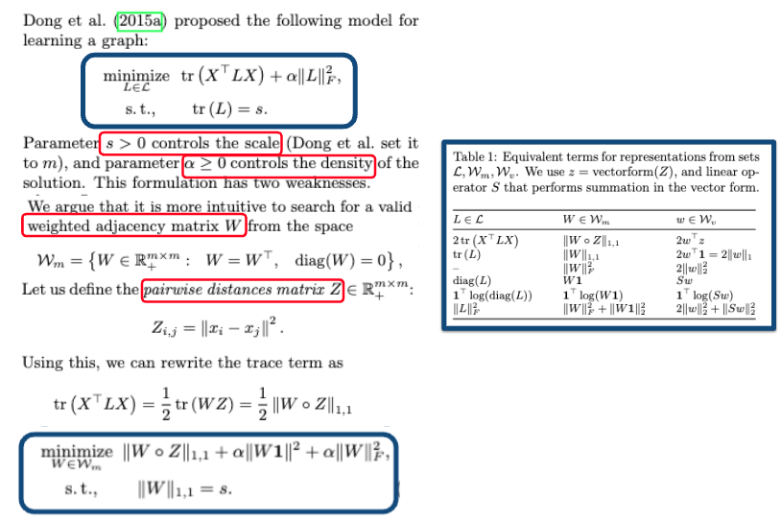
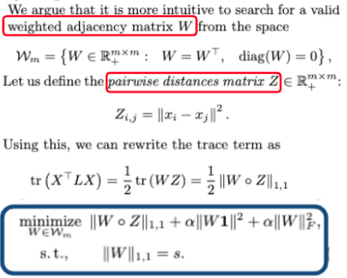
A Simplified Objective Function - Kalofolias 2016
Mapping of terms (from L to W)
in efficiency and explainability
The notation ||W||1,1 represents the element-wise norm-1 of a matrix W, computed as: ||W||1,1 = Σ |Wij| for all elements Wij in the matrix W

Slide 30
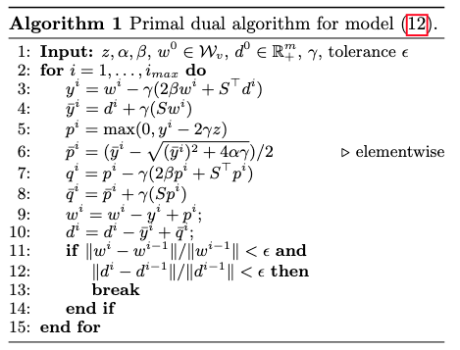
Kalofolias - The Optimization Algorithm
Objective Function Minimization: The input parameters are used to guide the optimization process towards finding the minimal solution for the weighted adjacency matrix W.
Variable Updates: The algorithm iterates by updating the variables wi and di based on the current values and the gradients of the objective function.
Complexity and Convergence: A complexity of O(m^2) per iteration for m nodes graphs and are guaranteed to converge to the minimum.

Slide 31
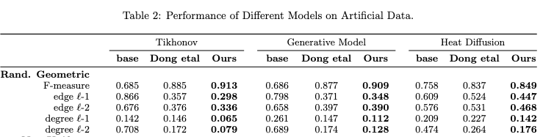
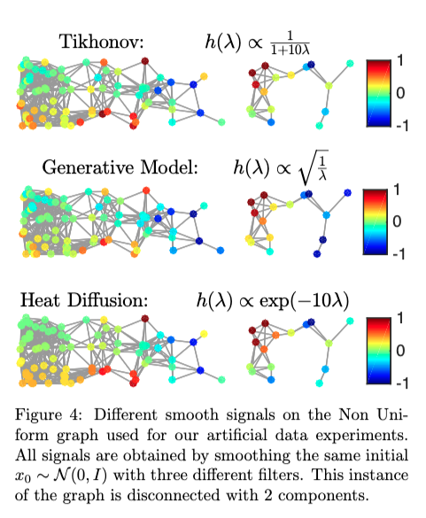
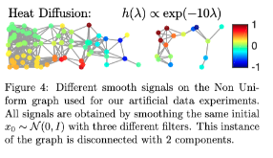

Kalofolias - Main contributions
In addition to simplifying the objective function, the method also:
Establishes a link between smoothness and sparsity - “Smooth manifold means graph sparsity”
Provides a scalable algorithm for learning graph structures under smoothness assumptions (by providing a fast and convergent algorithm)
Gets great results on Artificial Data
Gets superior results than Dong and K-NN on clustering Real Data (USPS and MINST digit images)
Publishes the code for his study

Slide 32
Applying These Methods on fMRI - Back to SGFC - 2021
SGFC: A regional fMRI BOLD signals time series matrix 𝐗 ∈ ℝ𝑁×𝑇, where 𝑁=268 is the number of functionally coherent regions and 𝑇 is the time-series length. The goal is to estimate a 𝑁 × 𝑁 FC matrix that captures inter-regional functional relationships.
We start by understanding the importance of the underlying graph and the concept of smoothness
Learning graphs from data
2013
Shuman et al.
The emerging field of signal processing on graphs: Extending high-dimensional data analysis to networks and other irregular domains
2015
Hu et al.
A Spectral Graph Regression Model for Learning Brain Connectivity of Alzheimer‘s Disease
Jan 2016
Kalofolias
How to learn a graph from smooth signals
Feb 2016
Dong et al.
Learning Laplacian Matrix in Smooth Graph Signal
Representations
2019
Dong et al.
Learning
Graphs
From Data
A signal representation perspective
2021
Gao et al.
Smooth graph learning for functional connectivity estimation
Introducing a graph regression model for learning brain structural connectivity of patients with Alzheimer’s disease, which is based on the signal smoothness model

Slide 33
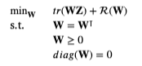
Smooth Graph Functional Connectivity (SGFC) Estimation
Takes the “column-wise” perspective.
Treats each time frame of the regional time series (i.e. each column of the data matrix 𝐗) as a graph signal lying on the brain graph.
As fMRI data is big and complex - they use Kalofolias’s optimization function.
This approach learns a sparse FC matrix via smooth graph learning.
Infers the graph by learning the weighted graph adjacency matrix based on the assumption of graph signal smoothness.
Node degree penalty: By penalizing nodes with small degrees, the algorithm encourages the functional connectivity graph to have a more connected structure.
Simplified optimization function (Kalofolias):

Slide 34

SGFC Experiments - Dataset Selection
Utilized the Human Connectome Project (HCP) 900 Subject Release.
Included individuals who participated in all 9 fMRI conditions (7 task, 2 rest).
Final sample: n = 506 (237 males, ages 22-37).

Slide 35
SGFC Experiments - fMRI Processing
Applied the HCP minimal preprocessing pipeline (Glasser et al., 2013) with:
Artifact removal
Motion correction
Registration to standard space
Additional preprocessing steps:
Regression of covariates of no interest (linear and quadratic drifts, CSF, white matter, gray matter signals)
Regression of a 24-parameter motion model.
Note: “Regression” means statistically removed or accounted for in the data analysis process
Measures taken to mitigate motion effects on functional connectivity.

Slide 36
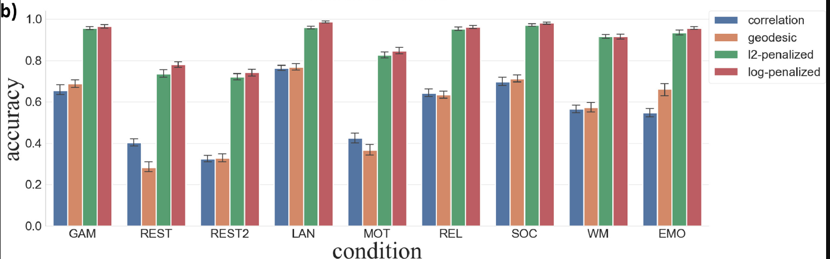
Experiment 1 - Comparison of SGFC and CFC for Fingerprinting
Experiment Description:
Compared Smooth Graph Functional Connectivity (SGFC) with Correlation Functional Connectivity (CFC) for participant identification (fingerprinting).
Evaluated fingerprinting accuracy across different experiment settings (7 tasks, 2 rests)
Results:
SGFC achieved higher fingerprinting accuracy compared to CFC.
Significant improvement observed, especially with shorter fMRI scanning lengths (176 TRs)
There is no significant difference in performance between logarithmic regularization graphs and l2-based regularization graphs, both performing significantly better than correlation-based graphs.
In most methods and tasks an SGFC graph with logarithmic regularization produces the highest-quality fingerprinting.

Slide 37
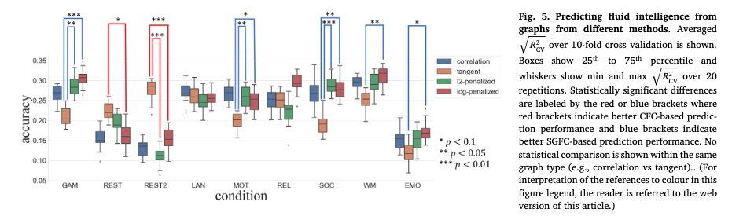
Experiment 2 - Prediction of Fluid Intelligence using SGFC
Experiment Description:
Used SGFC to predict fluid intelligence based on functional connectivity patterns.
Investigated the cognitive relevance of SGFC in predicting individual differences in fluid intelligence.
Results:
SGFC demonstrated predictive power for fluid intelligence.
Validated the cognitive relevance of SGFC in capturing individual cognitive traits.
Significant differences in prediction performance are indicated by colored brackets:
red brackets suggest better performance by CFC-based methods
blue brackets suggest better performance by SGFC-based methods.

Slide 38
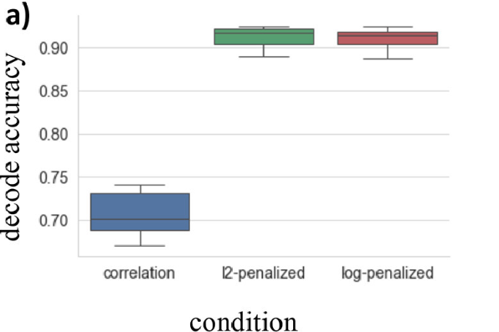
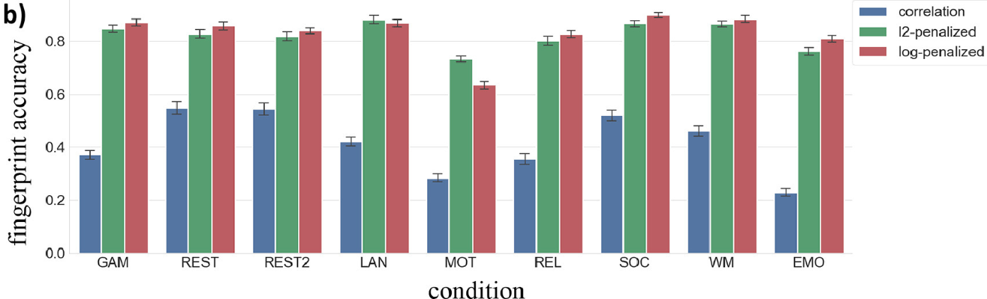
Experiment 3 - Topological Analysis of Sparse Graphs
Experiment Description:
The focus here is on the topological structure of functional connectivity (FC) networks and the impact of different methods on creating networks with unique and identifiable topologies.
3 types of FC networks were used:
CFC, SGFC l2-penalized/log penalized.
Absolute weight values were used to calculate node degrees, and sparsification was performed to reduce the number of edges per node (retaining only edges with highest values)
Results:
The 2 versions of SGFC exhibited high accuracy in identifying unique topologies.
The generated topological structure was reliable and consistent, leading to improved identification of significant topological patterns.

Slide 39
Conclusions - SGFC - A Novel Approach to fMRI Data Studies
Introduction of Novel Approach:
Leveraging graph signal processing techniques to infer brain connectivity patterns from fMRI data.
Introduces Smooth Graph Functional Connectivity (SGFC) concept, treating brain activity as graph signals on an underlying brain graph.
Inference Process:
Traditional approaches use pairwise Pearson correlation coefficients on regional time-series signals for FC matrix calculation.
SGFC views data columns as graph signals on a latent functional brain graph.
Inference process directly infers brain graph from fMRI data, guided by node degree penalty and a hyperparameter for graph sparsity control.

Slide 40

Conclusions - SGFC Advantages Over Traditional Methods
Reliability and Robustness:
Reducing noisy connections
Generating biologically meaningful brain graphs
Exhibiting high Small-Worldness propensity (SWP) and modularity scores.
Demonstrates the reliability and robustness of SGFC estimates of the network topology through downstream analysis tasks.
Validates the cognitive relevance of SGFC in capturing individual cognitive traits.
outperforms traditional methods in terms of fingerprinting accuracy (especially with shorter fMRI scanning lengths).
Sparse Graph Representation
Non-Negative Edge Weights

Slide 41

Future Research Directions
Explore classification applications and further topological measure-based FC analyses to enhance understanding of brain topological structures.
Clustering and comparing clusters of NC subjects to subjects with a specific medical condition.
Use to generate better representation of the data for ANNs: https://medium.com/towards-data-science/combine-text-embeddings-and-knowledge-graph-embeddings-in-rag-systems-5e6d7e493925
Go back to past studies such as "A Spectral Graph Regression Model" and review them with fMRI data (and a functional Atlas such as Shen 2013)

Slide 42
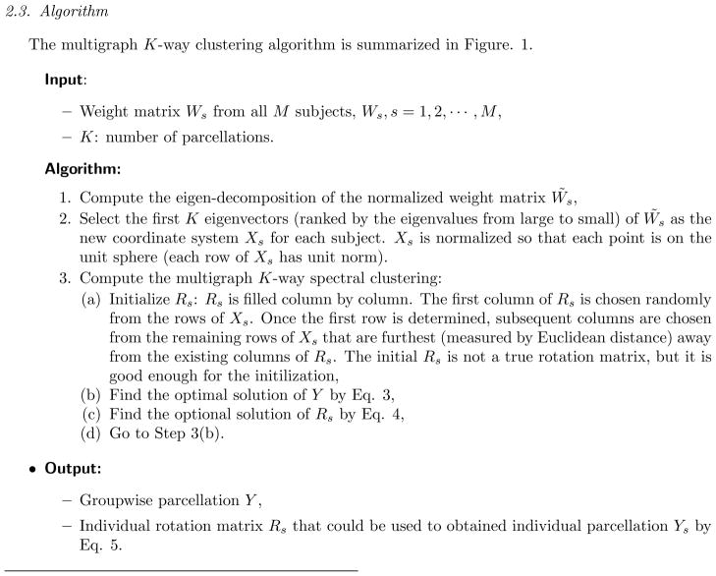


Groupwise whole-brain parcellation from resting-state fMRI data for network node identification (Atlas by Shen et al. 2013)

Slide 43

THANK YOU
Any questions?

